Slide 1
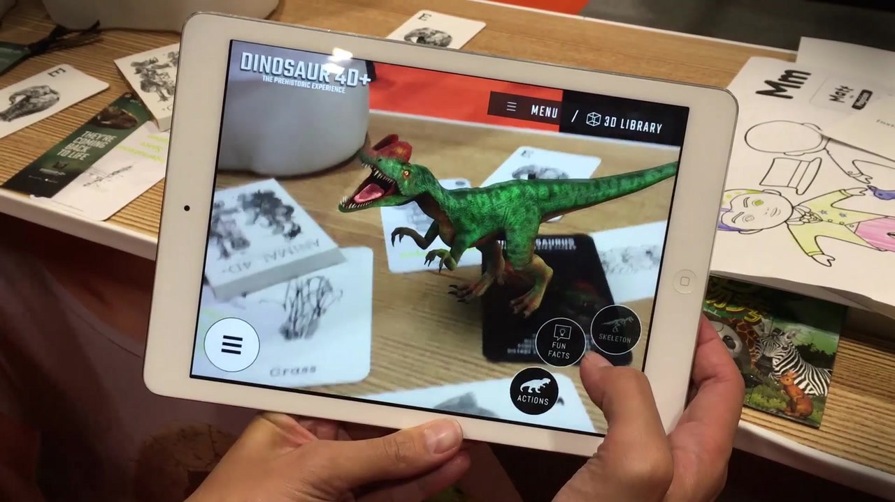
AR-FLASHCARDS
By: ABHIJITH K.D.
ABRAHAM N.T.
ANJALI R
KAVYA L

Slide 2
Contents
INTRODUCTION
EXISTING SYSTEM
DRAWBACKS OF EXISTING SYSTEM
PROPOSED SYSTEM
ADVANTAGES OF PROPOSED SYSTEM
CONCLUSION

Slide 3
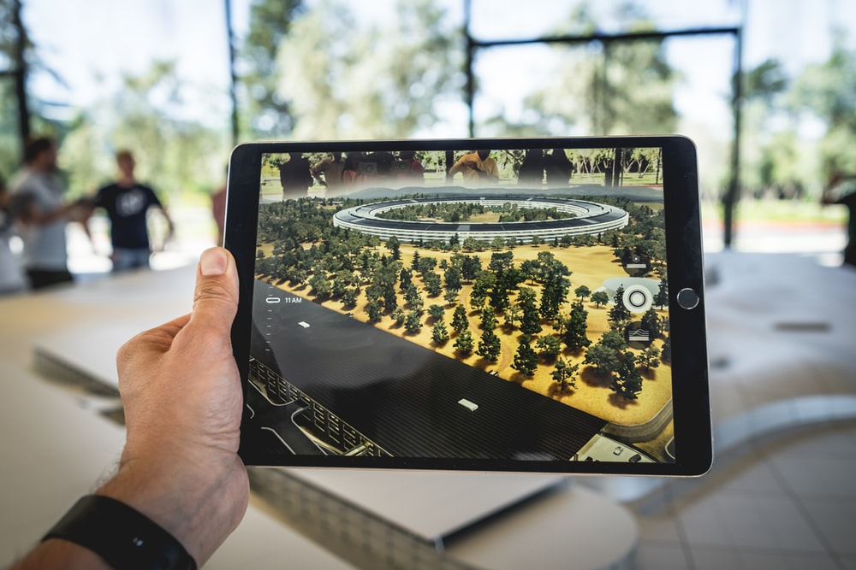
WHAT IS AUGMENTED REALITY(AR).......?

Slide 4
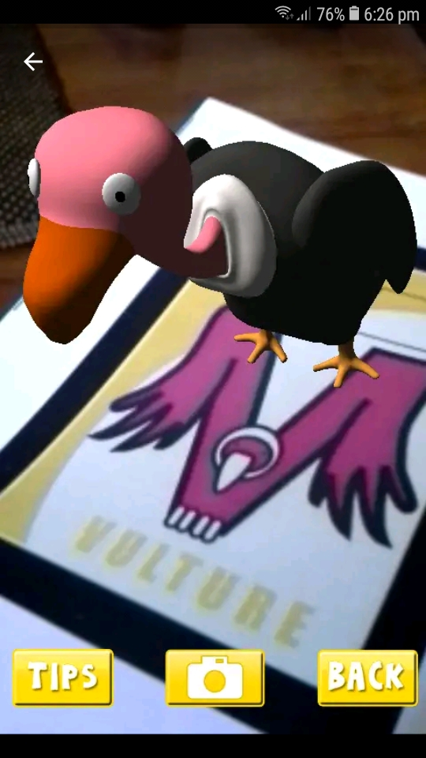
EXISTING SYSTEM : AR FLASHCARDS
The available system is AR flashcards App.
It has there own flashcards.
AR 3D version is produced.
Easy way to study, especially for children.
It enhance the knowledge and data.
Better user experience.

Slide 5
flowchart
Print the flash cards
Scan the flashcards
Scan
successful
No
Yes
A

Slide 6
A
Identify the character
Produce AR of an animal corresponding to the character
end

Slide 7
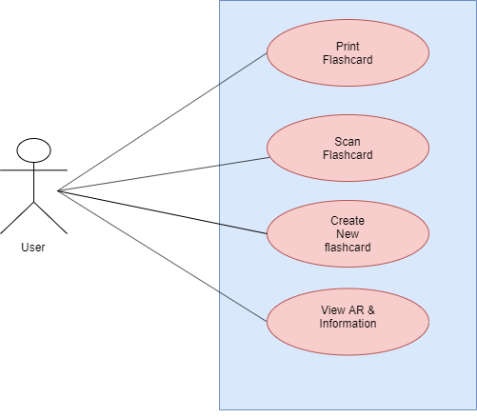
USECASE DIAGRAM

Slide 8
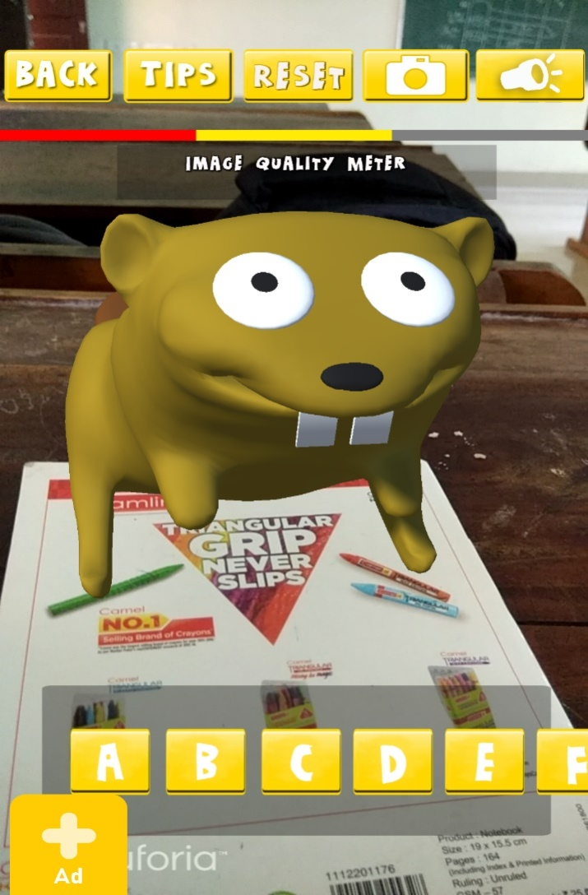
DRAWBACKS
Predefined images of animals.
‘Create’ option not working properly
Performance issue ,interactive issue , and alignment issue.
Weakening to identify proper user inputs.

Slide 9
PROPOSED SYSTEM
The system is an application which scans
the letters
A word
An image
Then producing the 3D AR & some details about it in the application as output.
Tensorflow – Used to identify the letter/word/image.
Vuforia – Used to generate 3D AR view.

Slide 10



TENSORFLOW
Machine Learning part
Import TensorFlowSharp
inside Unity.
Comes with preinstalled in Colab .
Connect Colab to google drive and so datasets from remote server.
UNITY
VUFORIA
World’s leading AR platform.
Install Vuforia Engine with the Unity editor.
Multi Target- Object with flat surfaces and multiple sides.
Generate 3D models.
Data
PROPOSED SYSTEM

Slide 11
IMPLEMENTATION STEPS
Import TensorFlow into Unity.
Import Vuforia into Unity.
Connect Training datasets with TensorFlow.
Scan images/Objects.
Export identified image to Vuforia.
Generate AR model of that image using Vuforia.
Display it in mobile screen.

Slide 12
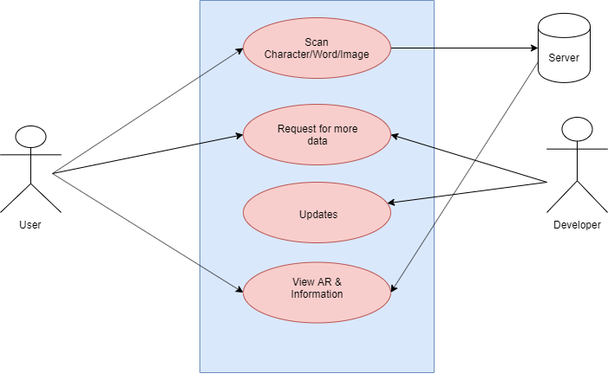
USECASE DIAGRAM

Slide 13
DATASET
CIFAR (Canadian Institute For Advanced Research)
CIFAR-10 dataset comprised of 60,000 images.
Sized 32*32 pixels (coloured images).
Used by CNN.
Along with standard associated integer values form 0-9.
50,000 training images
10,000 test images.
The classes are mutually exclusive.

Slide 14
CNN (Convolutional Neural network)
type of neural network uses perceptrons.
Supervised learning to analyze data.
Also known as ConvNet.
improve accuracy of image classification.
Work in the same way of a regular neural network.
Images are broken into tiles , tries to predict each tile.

Slide 15
Image processing

Slide 16
STEP 1
Choose the parameters.
Apply filters with strides, padding if required
Perform convolution on image and apply ReLU activation to matrix.
STEP 2
Perform pooling to reduce size.
Add as many convolutional layers until satisfied.
STEP 3
Flatten and feed to FC layer.
Output the class using activation function and classify images.

Slide 17
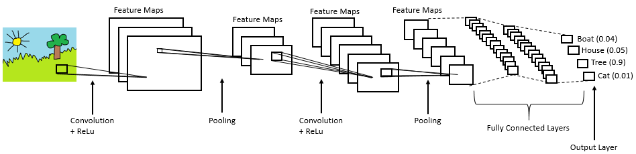

Slide 18
Block diagram

Slide 19
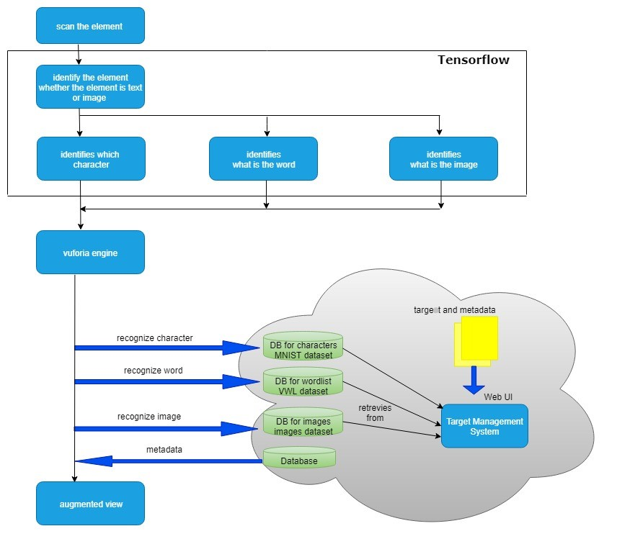

Slide 20
flowchart

Slide 21
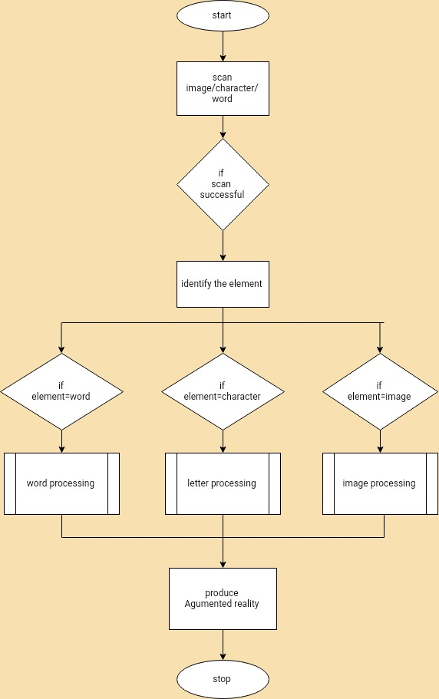

Slide 22
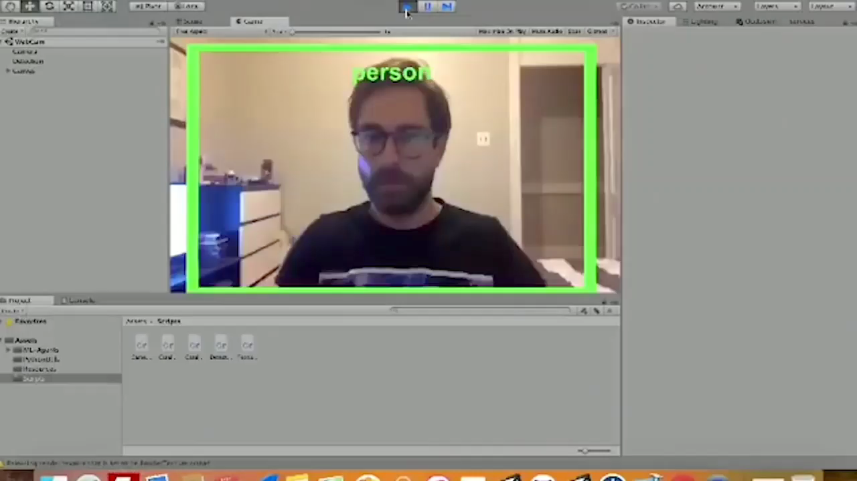
OBJECT IDENTIFICATION USING TENSORFLOW

Slide 23
ADVANTAGEs
Through this wider range of students can use this and learn faster.
Producing 3D image will change the way children learn.
More efficient and effective.

Slide 24
Conclusion
Limitations of existing system.
The new system overcomes the limitations
The new system has more advantages.

Slide 25
references
https://towardsdatascience.com/cifar-10-image-classification-in-tensorflow-5b501f7dc77c
https://towardsdatascience.com/cifar-10-image-classification-in-tensorflow-5b501f7dc77c
https://www.techopedia.com/definition/32731/convolutional-neural-network-cnn
https://towardsdatascience.com/cifar-10-image-classification-in-tensorflow-5b501f7dc77c
https://towardsdatascience.com/cifar-10-image-classification-in-tensorflow-5b501f7dc77c
https://www.techopedia.com/definition/32731/convolutional-neural-network-cnn

Slide 26
Thank you

